Slide 1
Course Map
Data Gathering
Classify Data
Data Exploration
Picturing Distributions with Graphs
Scatterplots and Correlation
Probability and Distributions
Introducing Probability
Sampling Distributions
Inferences about a Population Mean
Inference
Sampling
Describing Distributions with Numbers
Experiments
Binomial Distributions
General Rules of Probability
Inferences about a Population Proportion
Confidence Intervals
Hypothesis Testing
Goals of Statistics
Regression
Normal Distributions
Practicing Statistics

Slide 2
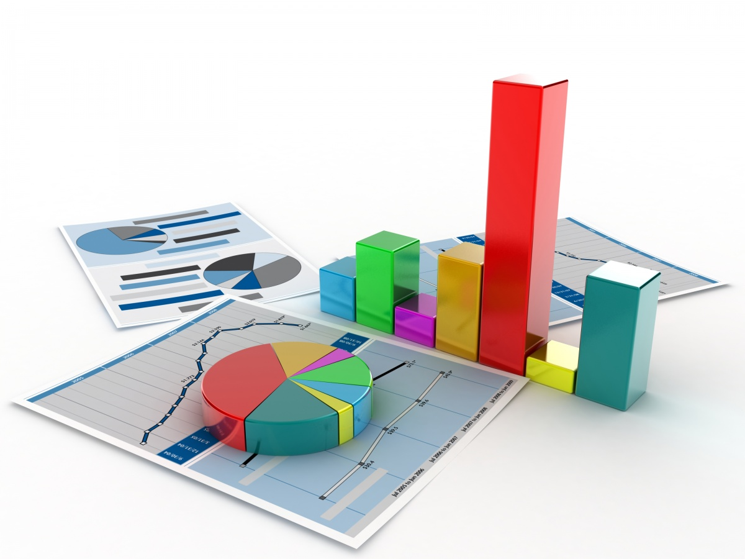
Today you will be able to…
Describe the distribution of a variable.
Construct and interpret pie charts and bar graphs.
Construct and interpret histograms and stemplots.
Construct and interpret time plots.

Slide 3
Picturing Distributions with Graphs
Describing Distributions with Numbers
Normal Distributions
Scatterplots and Correlation
Regression
Examine each variable by itself
Picturing Distributions with Graphs
Describing Distributions with Numbers
Normal Distributions
Study the relationships among variables
Scatterplots and Correlation
Regression
Data Exploration

Slide 4
Recall
Statistics is the science of data.
The first step in dealing with data is to organize your thinking about the data:
Individual
An object described by data
Categorical Variable
Places individual into one of several groups or categories.
Variable
Characteristic of the individual
Quantitative Variable
Takes numerical values for which arithmetic operations make sense.

Slide 5
Picturing Distributions with Graphs
Each variable has a distribution that tells us
What values the variable takes
How often it takes these values
Distributions can be visualized using graphs
The type of graph depends on the type of variable.

Slide 6
Categorical Variables
The distribution shows the categories and gives counts or percentages of the individuals in each
Pie Chart
Shows the distribution as slices of a ‘pie’ with each slice scaled to represent the portion of individuals in that slice
Counts or percentages must include all individuals with no overlap
Bar Graph
Shows the distribution as bars that represent each category and whose heights show the category counts or percentages
Counts or percentages may overlap
Gap between bars/categories

Slide 7
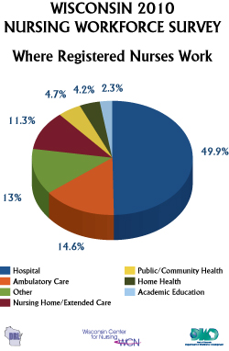
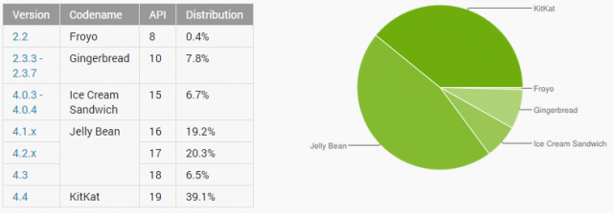
Pie Charts
Android software versions with distribution by user.

Slide 8
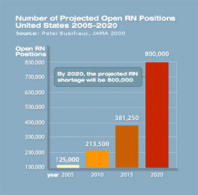
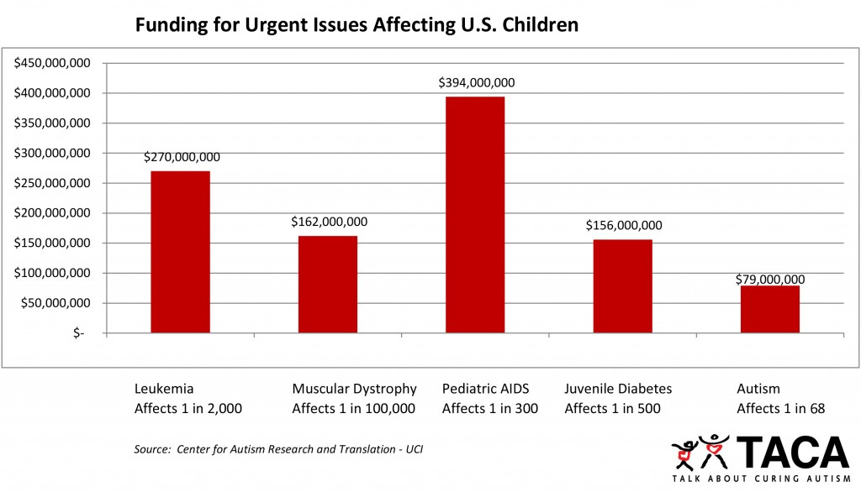
Bar Graphs

Slide 9
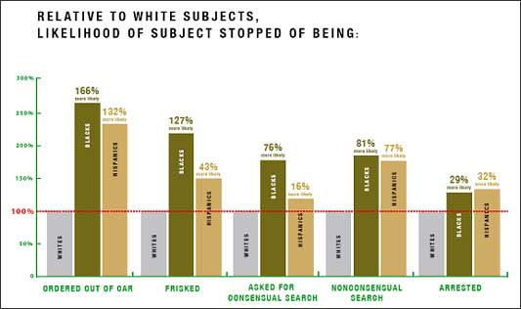
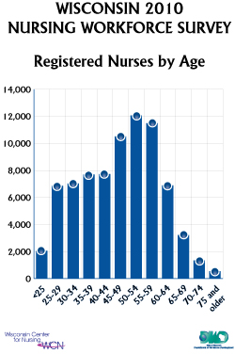
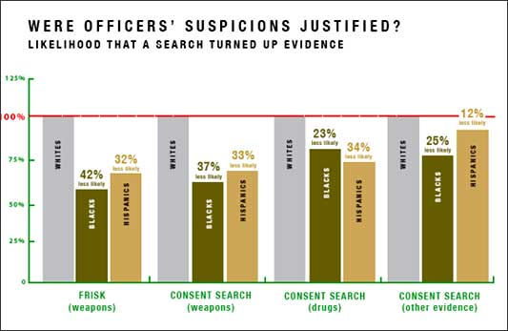
Bar Graphs

Slide 10
Quantitative Variables
The distribution shows the numbers the variable takes on and how often different groups, or classes, of the numbers occur
Histogram
Shows the distribution as bars whose height represents the number of individuals who take on a value within a particular class
No gaps between bars unless no data falls in the class
Stemplot
Shows the distribution with the original values of the variable but with the values grouped by a ‘stem’ class.

Slide 11
Histograms
For quantitative variables that take many values and/or large datasets.
Divide the possible values into classes (equal widths).
Count how many observations fall into each interval (may change to percents).
Draw picture representing the distribution―bar heights are equivalent to the number (percent) of observations in each interval.

Slide 12
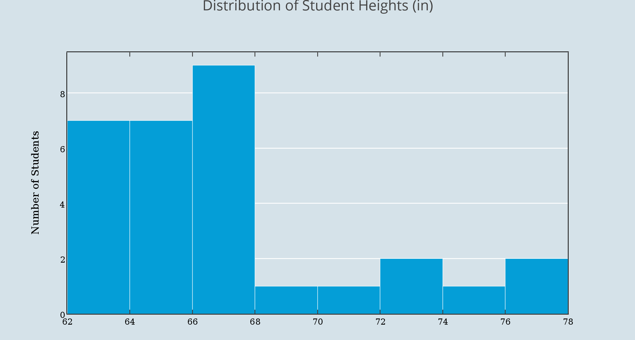
Histograms

Slide 13
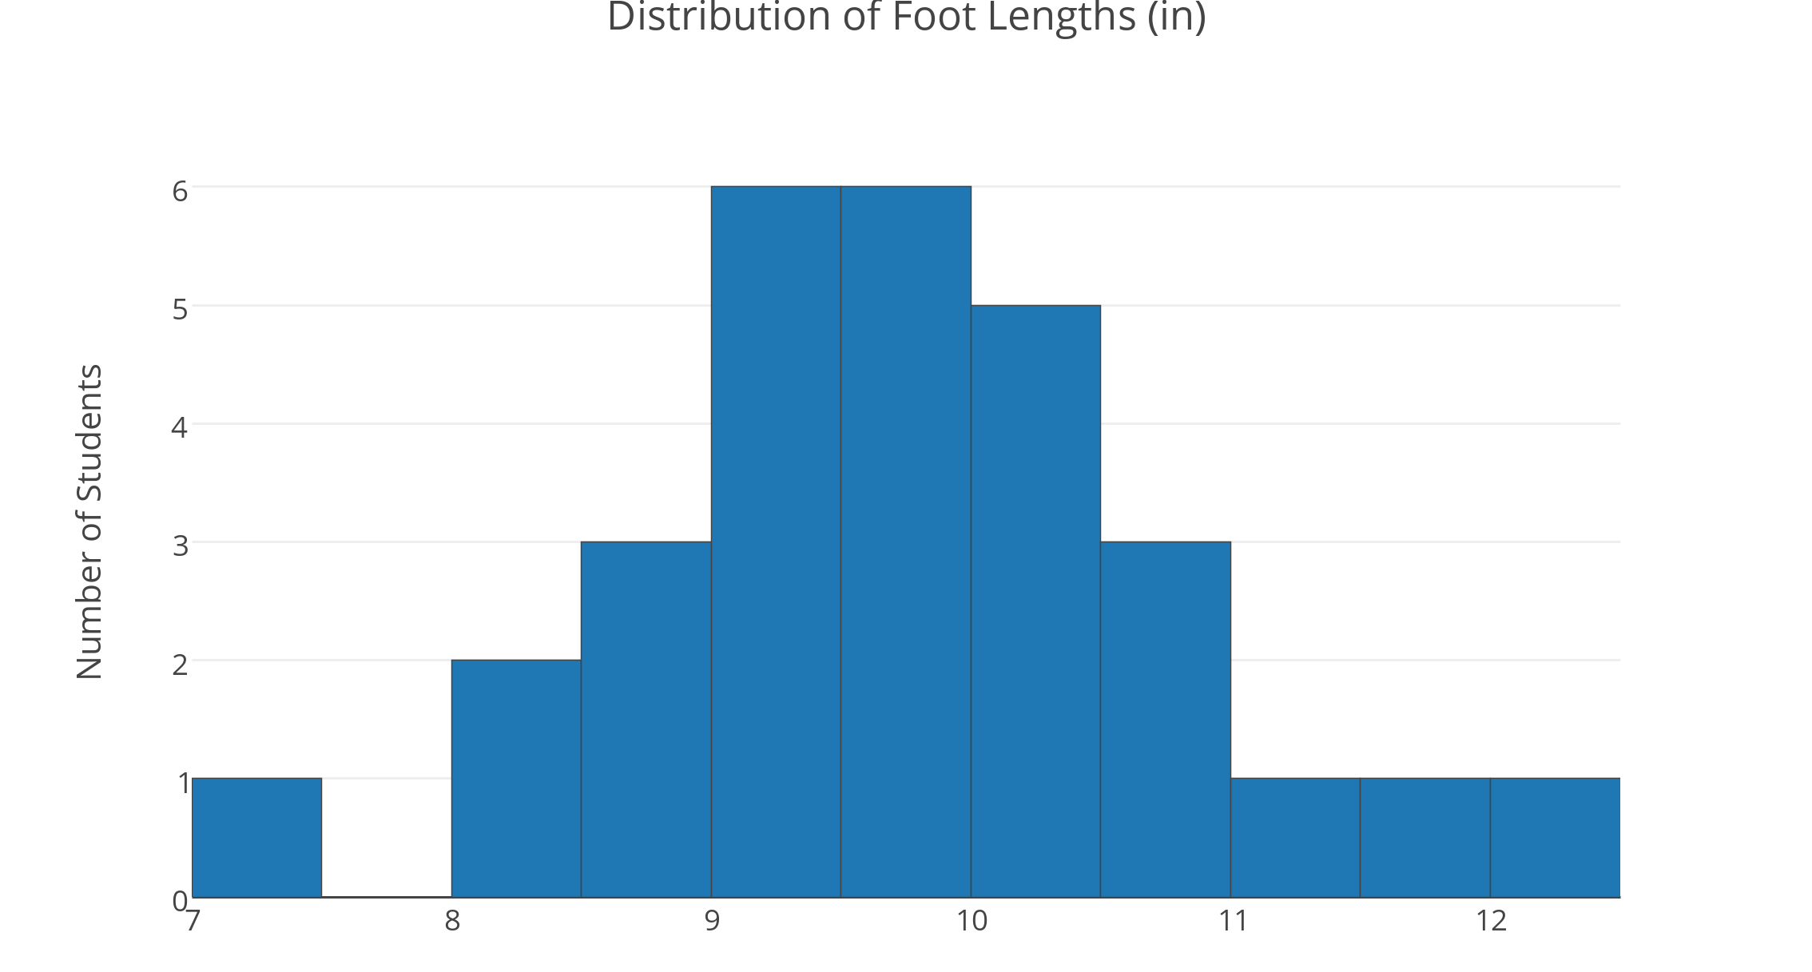
Histograms

Slide 14
Stemplots (Stem-and-Leaf Plots)
For quantitative variables.
Separate each observation into a stem (first part of the number) and a leaf (the remaining part of the number).
Write the stems in a vertical column; draw a vertical line to the right of the stems.
Write each leaf in the row to the right of its stem; order leaves if desired.

Slide 15
Stemplots
Example: Weight Data – Introductory Statistics Class
10 0166
11 009
12 0034578
13 00359
14 08
15 00257
16 555
17 000255
18 000055567
19 245
20 3
21 025
22 0
23
24
25
26 0
5
2
2
Key
20|3 means 203 pounds
Stems = 10’s Leaves = 1’s
Stems
Leaves

Slide 16
Stemplots (Stem-and-Leaf Plots)
If there are very few stems (when the data cover only a very small range of values), then we may want to create more stems by splitting the original stems.
Example: If all of the data values were between 150 and 179, then we may choose to use the following stems:
15 15 16 16 17 17
Leaves 0-4 would go on each upper stem (first “15”), and leaves 5-9 would go on each lower stem (second “15”).

Slide 17
Describing Distributions
In any graph of data, look for the overall pattern and for striking deviations from that pattern.
You can describe the overall pattern by its shape, center, and spread.
An important kind of deviation is an outlier, an individual that falls outside the overall pattern.

Slide 18
Describing Distributions
A distribution is symmetric if the right and left sides of the graph are approximately mirror images of each other.
A distribution is skewed to the right (right-skewed) if the right side of the graph (containing the half of the observations with larger values) is much longer than the left side.
It is skewed to the left (left-skewed) if the left side of the graph is much longer than the right side.
Symmetric
Skewed-left
Skewed-right

Slide 19
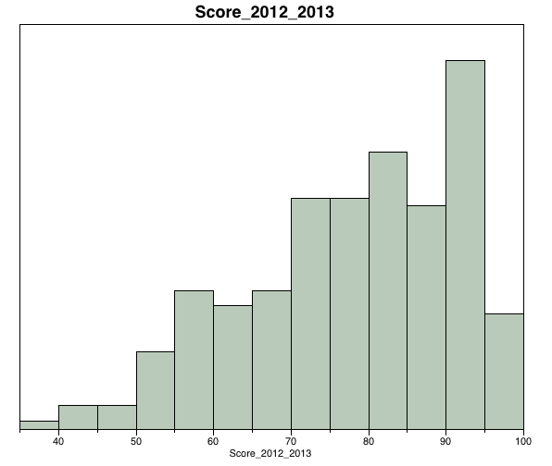
Symmetric, Skewed-Right, -Left?

Slide 20
Time Plots
A time plot shows behavior over time.
Time is always on the horizontal axis, and the variable being measured is on the vertical axis.
Look for an overall pattern (trend), and deviations from this trend. Connecting the data points by lines may emphasize this trend.
Look for patterns that repeat at known regular intervals (seasonal variations).

Slide 21
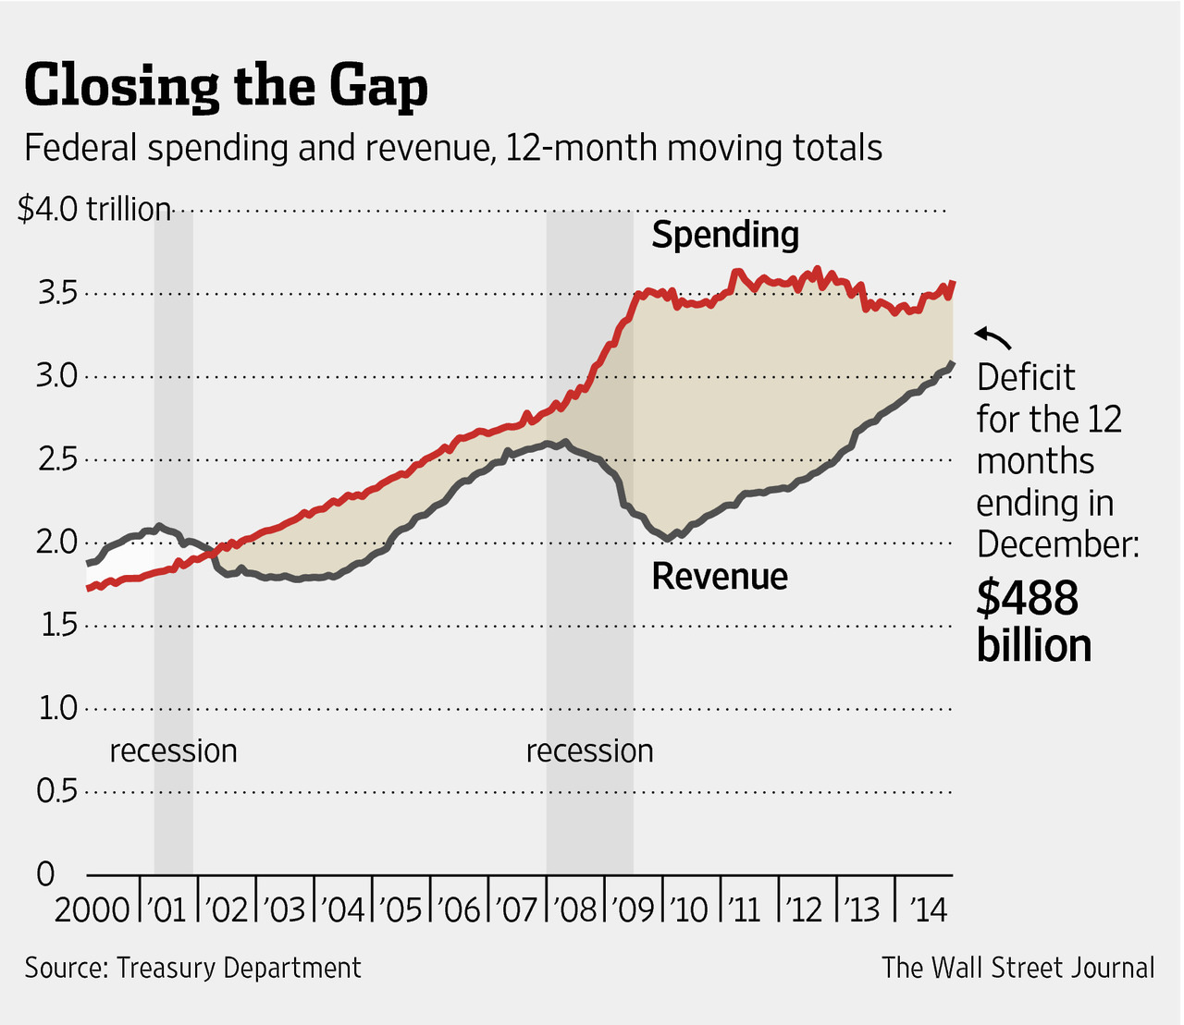
Time Plots

Slide 22
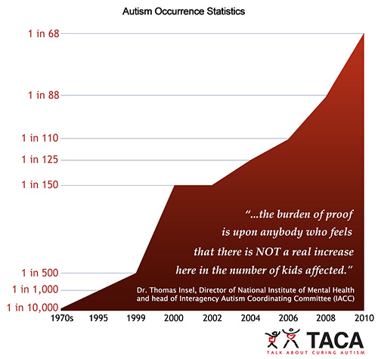
Time Plots

Slide 23
Chapter 1 Objectives Review
Define statistics.
Define individuals and variables.
Categorize variables as categorical or quantitative.
Describe the distribution of a variable.
Construct and interpret pie charts and bar graphs.
Construct and interpret histograms and stemplots.
Construct and interpret time plots.

